Slide 1

2 chronicles 5:1 – 8:18
A CD of this message will be available (free of charge immediately following today's message
This message will be available via podcast later this week at calvaryokc.com

Slide 2
2 chronicles 5:1 – 8:18
A CD of this message will be available (free of charge immediately following today's message
This message will be available via podcast later this week at calvaryokc.com

Slide 3
2 chronicles 5:1 – 8:18
Dedicated ~ qodesh (holy)

Slide 4
2 chronicles 5:1 – 8:18
Inner sanctuary ~ KJV, oracle

Slide 5
2 chronicles 5:1 – 8:18
Ps. 89:30-37 ~ ³⁰ If his sons forsake My law
And do not walk in My judgments,
³¹ If they break My statutes
And do not keep My commandments,
³² Then I will punish their transgression with the rod,
And their iniquity with stripes.
³³ Nevertheless My lovingkindness I will not utterly take from him,
Nor allow My faithfulness to fail.
³⁴ My covenant I will not break,
Nor alter the word that has gone out of My lips.
³⁵ Once I have sworn by My holiness;
I will not lie to David:
³⁶ His seed shall endure forever,
And his throne as the sun before Me;
³⁷ It shall be established forever like the moon,
Even like the faithful witness in the sky.” Selah

Slide 6
2 chronicles 5:1 – 8:18
Oath ~ i.e. oath of innocence
1 John 1:9 ~ If we confess our sins, He is faithful and just to forgive us our sins and to cleanse us from all unrighteousness.

Slide 7
2 chronicles 5:1 – 8:18
Come to themselves ~ KJV, bethink themselves

Slide 8
2 chronicles 5:1 – 8:18
Feast of Tabernacles (Sukkot)
15-21 Tishri (Sept. – Oct.)
John 7:37-38 ~ ³⁷ On the last day, that great day of the feast, Jesus stood and cried out, saying, “If anyone thirsts, let him come to Me and drink. ³⁸ He who believes in Me, as the Scripture has said, out of his heart will flow rivers of living water.”

Slide 9
2 chronicles 5:1 – 8:18
Pray ~ palal – to intercede

Slide 10
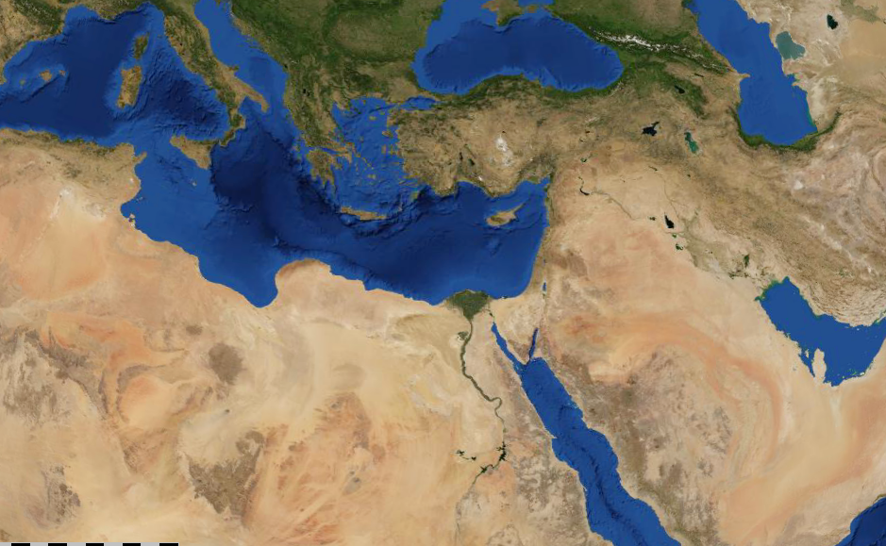
2 chronicles 5:1 – 8:18
Hamath
Beth Horon
Tadmor
Elath
Ophir

